Slide 1
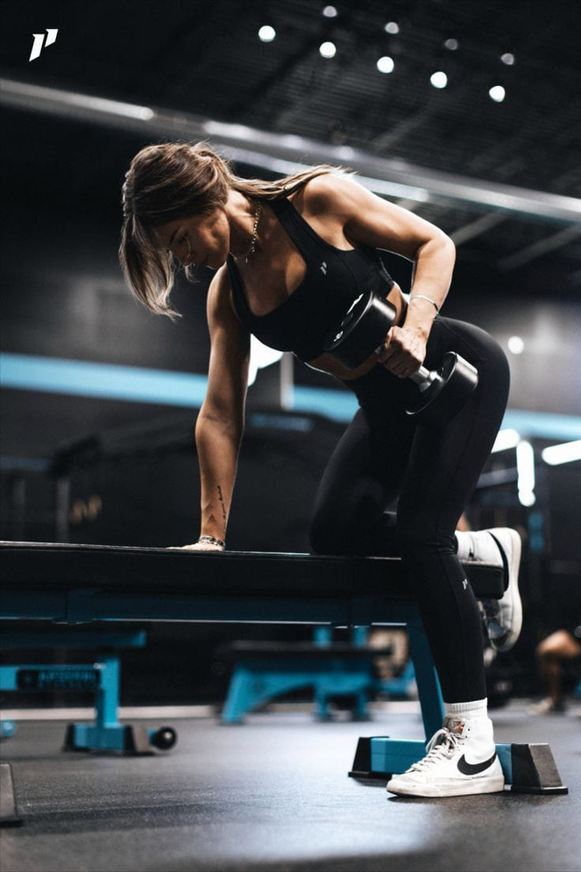

VALLIAMMAL COLLEGE FOR WOMEN
FITFLEX
Team ID:SWTID17412489741499812
Team Leader: Pooja.S
Team Leader: Pradisha.V
Team Member: Prathiksha.G.V
Team Member: Priya dharshini.T
poojas22cs059@gmail.com
pradishav22cs060@gmail.com
prathikshagv22cs061@gmail.com
priyadharshinit22cs062@gmail.com

Slide 2
TEAM MEMBERS AND THEIR ROLES
Pooja.S-Search and Filter Module
Pradisha.V-API Introduction Module
Prathiksha.G.V- User Interface Module, Excercise Management Module
Priya dharshini.T-User interaction and Personalization Module

Slide 3
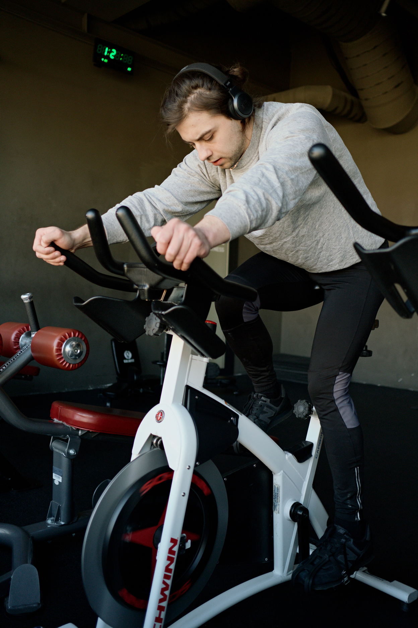
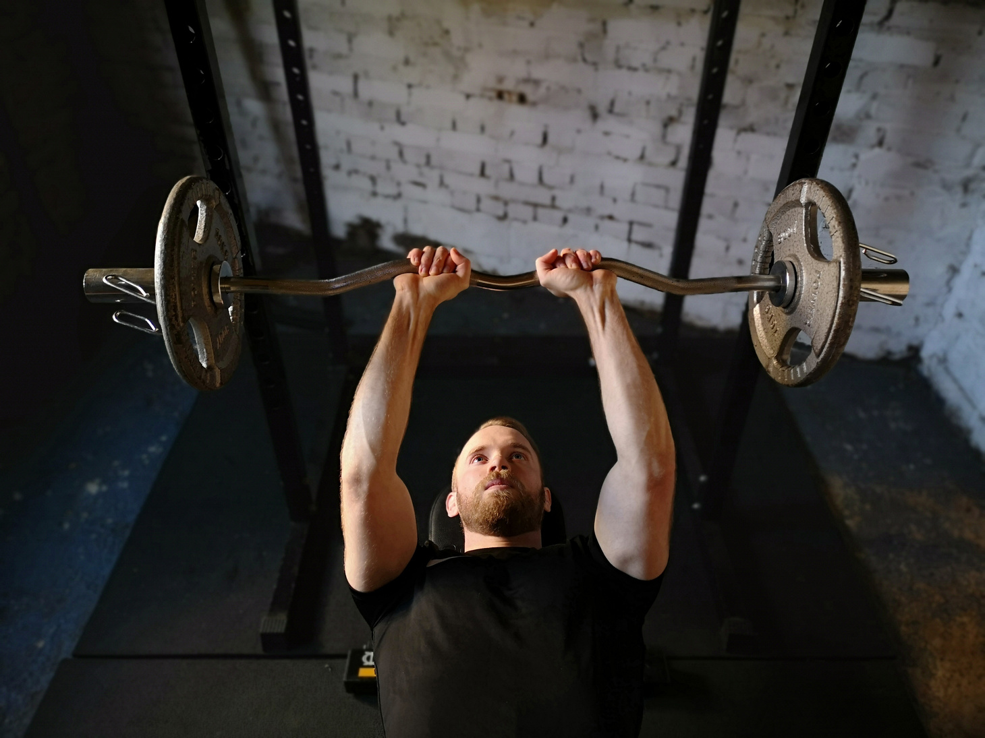
INTRODUCTION
IntroductionFit Flex is a versatile platform designed to enhance fitness experiences by providing personalized workout plans, tracking progress, and offering a community-based environment. It helps individuals achieve their fitness goals through tailored exercise routines, progress monitoring, and access to a wide range of workouts and challenges.
The platform promotes flexibility, enabling users to adjust their routines according to their personal fitness levels and preferences, while fostering a supportive community that encourages motivation and accountability.

Slide 4
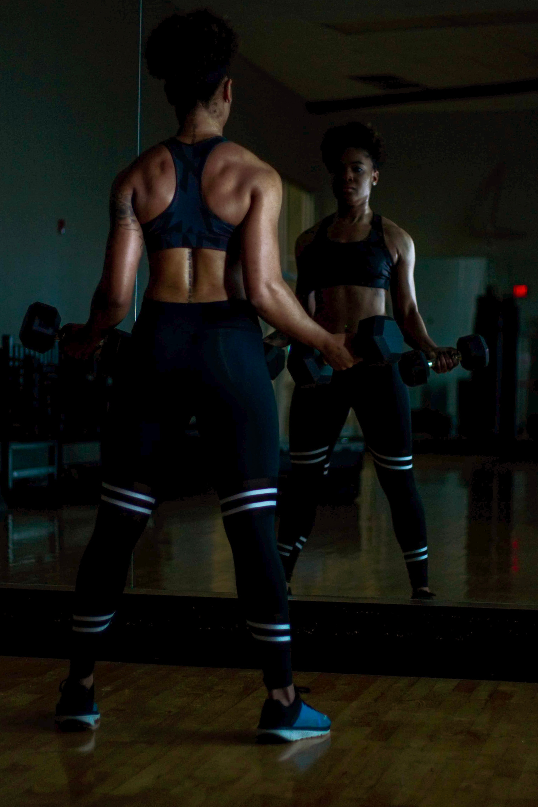

OBJECTIVE
The overarching aim of SB Fitzz is to offer an accessible platform tailored for individuals passionate about fitness, exercise, and holistic well-being.
Our key objectives are as follows:
1.User-Friendly Experience
2.Comprehensive Exercise 3.Management
Technology Stack

Slide 5
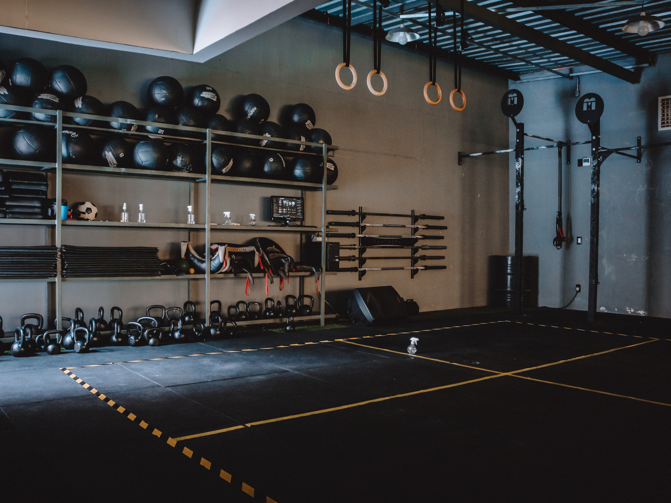
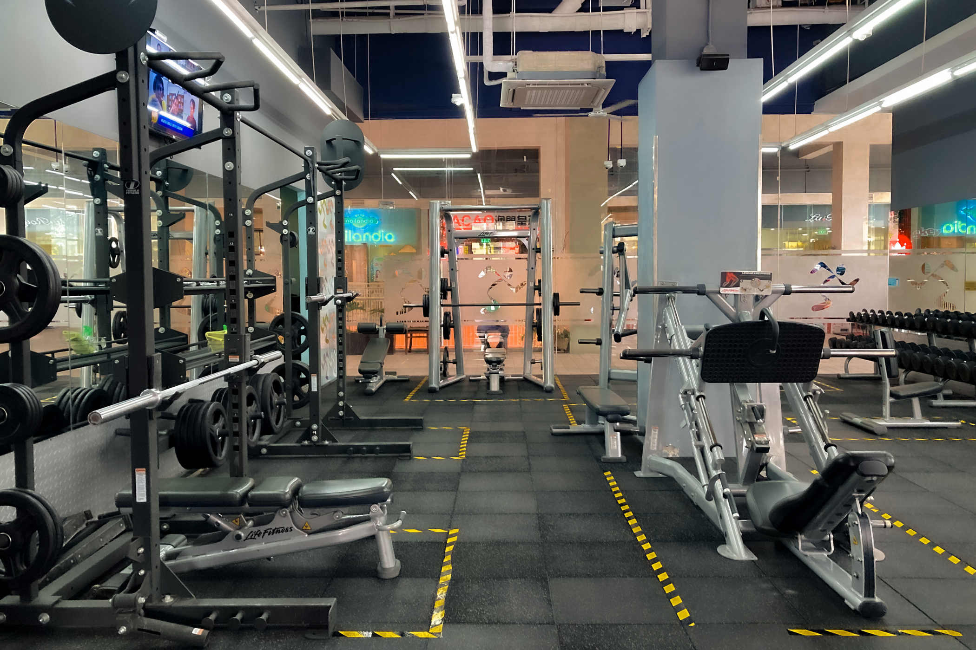
PROPOSED
02
Solution Description
01
Problem Statement
Users struggle to find structured workout plans tailored to their needs.
A React.js-based fitness web application categorized by body parts and equipment.
STATEMENT
02
03
Novelty/Uniqueness
Free and structured access to categorized workouts.

Slide 6

SOLUTION
ARCHITECTURE
Frontend: React.js, CSS, React Fa Icons.
Backend/API Handling: JavaScript, Axios.
External API: ExerciseDB (via RapidAPI).
Security: HTTPS, API Key Authentication.
03

Slide 7

MODULE DESCRIPTION
USER INTERFACE MODULE
Components: Navbar, Hero, Search Bar, Category Display, Footer
Features:
Provides seamless navigation across the application
Displays trending workouts and fitness challenges
Allows users to search for exercises by name, category, or equipment
Showcases different workout categories visually
EXERCISE MANAGEMENT MODULE
Components: Exercise List, Exercise Details Page
Features:
Fetches exercises from the RapidAPI Exercise Database
Displays exercise details including name, instructions, targeted muscle groups, and difficulty level
Integrates multimedia resources such as images and YouTube videos for exercise demonstrations

Slide 8
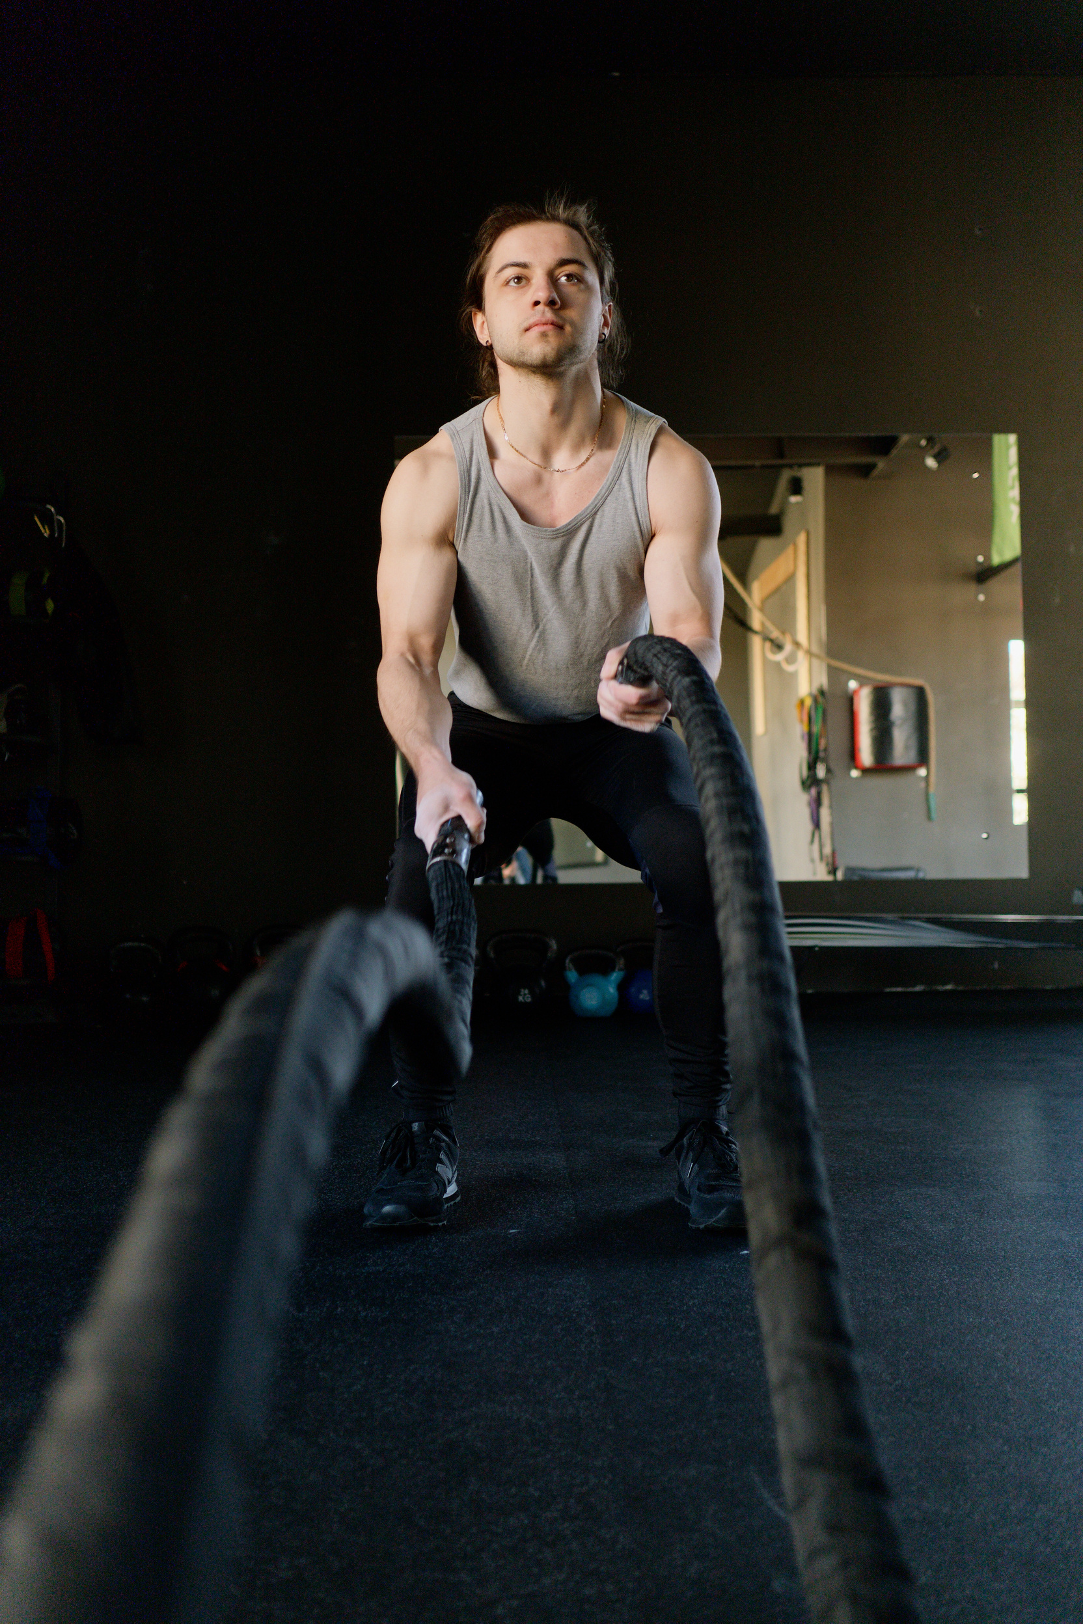
SEARCH AND FILTER MODULE
Components: Search Bar, Category Selector
Features:
Implements an advanced search feature to find exercises based on keywords, equipment, and muscle group.
Fetches relevant workout data dynamically
Provides filtering options for refined search results
01
API INTRODUCTION MODULE
02
Dependencies: Axios, React Query
Features:
Fetches data from external APIs using Axios
Retrieves available equipment and body parts lists
Fetches exercise details and related YouTube videos
Implements caching for efficient API usage

Slide 9
SPRINT PLANNING &
DEVELOPMENT PHASE
USER INTERACTION & PERSONALIZATION MODULE
Components: Favorites, Workout Plans, Newsletter Subscription.
features:
Allows users to save favorite exercises
Enables subscription to a newsletter for fitness tips and updates
Provides personalized workout recommendations
Sprint Planning & Development Phases
Sprint 1: UI setup, homepage navigation, API integration.
Sprint 2: Exercise listing, detailed exercise pages.
Sprint 3: UI enhancement, error handling.
Sprint 4: Search feature, responsive design.

Slide 10

FUTURE ENHANCEMENTS
Integrate social sharing features
Add gamification elements
Incorporate wearable device integration
Expand exercise database
Implement personalized coaching
Enhance mobile app
CONCLUSION
FitFlex is a user-friendly fitness web application.
It provides personalized workout plans and tracks progress.
Key features include filtering, search, and responsive design.
FitFlex helps users achieve their fitness goals.

Slide 11
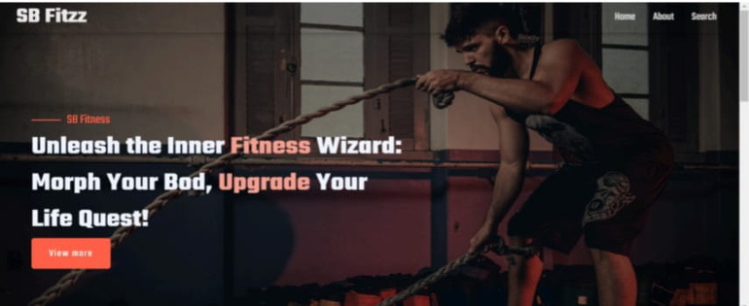
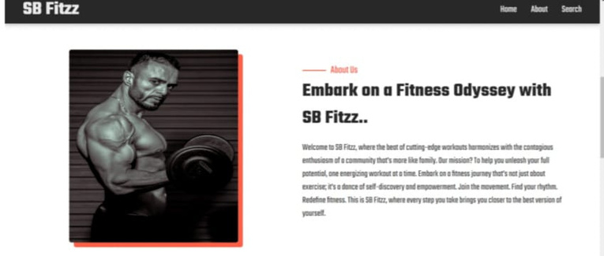
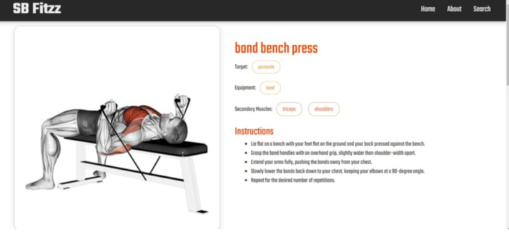
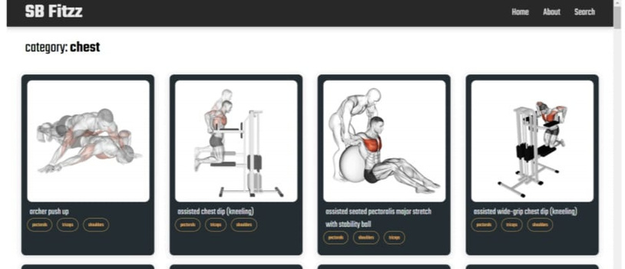
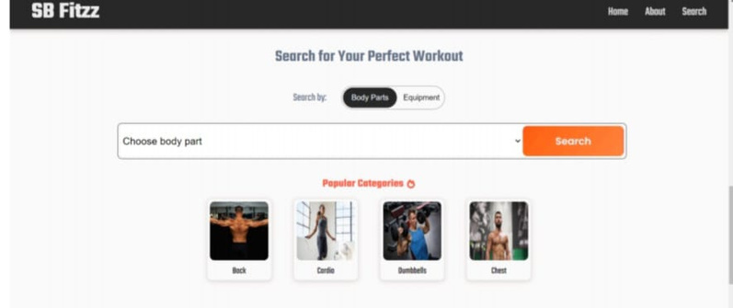
SCREENSHOTS

Slide 12

REFERENCE
https://github.com/pooja02005/FitFlex_Pooja.S
https://drive.google.com/file/d/1MGfd-d2iG8HTVV44nUGlzFqKn6IO4qX3/view?usp=sharing

Slide 13

THANK YOU

